Slide 1
Digital Design &
Computer Architecture
Sarah Harris & David Harris
Appendix C:
C Programming

Slide 2
Appendix C :: Topics
C Basics
Functions
Operators
Control Flow
Loops
Arrays & Strings
Structures
Memory
Pointers
Dynamic Memory Allocation

Slide 3
Overview
C programming language developed at Bell Labs around 1973
Capable of controlling a computer to do nearly anything, including directly interacting with the hardware
Suitable for generating high performance code
Relatively easy to use
Available from supercomputers to microcontrollers
Closely related to other important languages including C++, C#, Objective C, Java, Arduino

Slide 4
C is Libertarian
Lets you do just about anything
Interacts directly with the hardware
Does NOT protect you from your own stupidity
Assumes YOU know the size of arrays and variables
Unless sandboxed, can write ANYWHERE in memory

Slide 5
Example
// factorial.c
// David_Harris@hmc.edu 22 October 2019
int fact(int n) {
if (n <= 1) return 1;
else return n*fact(n-1);
}
void main(void) {
int result;
result = fact(4);
}

Slide 6
Steps to C Programming
Write code
Compile code
Execute code
Debug code

Slide 7
Appendix C: C Programming
C Basics

Slide 8
Comments
Single-line comments begin with “//” and continue to the end of the line.
x += 2; //This is a single-line comment.
Multi-line comments begin with “/*” end with “*/”.
/* You can hide or disable a section of code such as this block with a multi-line comment
x = bob ? x : y;
y -= 5;
*/
Always start code with the file name, your name, email, and date. This gives you copyright ownership & helps the next programmer track you down.

Slide 9
Constants, Defines, or Macros
Constants are named using the #define directive
#define MAXGUESSES 5
#define PI 3.14159
The # indicates that this line in the program will be handled by the preprocessor.
Before compilation, the preprocessor replaces each occurrence of the identifier MAXGUESSES in the program with 5.
By convention, #define lines are located at the top of the file and identifiers are written in all capital letters.

Slide 10
Global and Local Variables
Global variables are declared outside of any function
Accessible from all functions
Often lead to hard-to-debug code
Should be avoided, especially in large programs
Local variables are declared inside a function
Only accessible in that function
Should be your preferred choice

Slide 11
Primitive Data Types

Slide 12
Integer Sizes
Integer sizes in C may vary with the machine
int may be 16 or 32 bits
long may be 32 or 64 bits
Best to use sized types if size truly matters
But their names are a bit cumbersome
#include <stdint.h>
Signed: int16_t, int32_t, int64_t
Unsigned: uint16_t, uint32_t, uint64_t

Slide 13
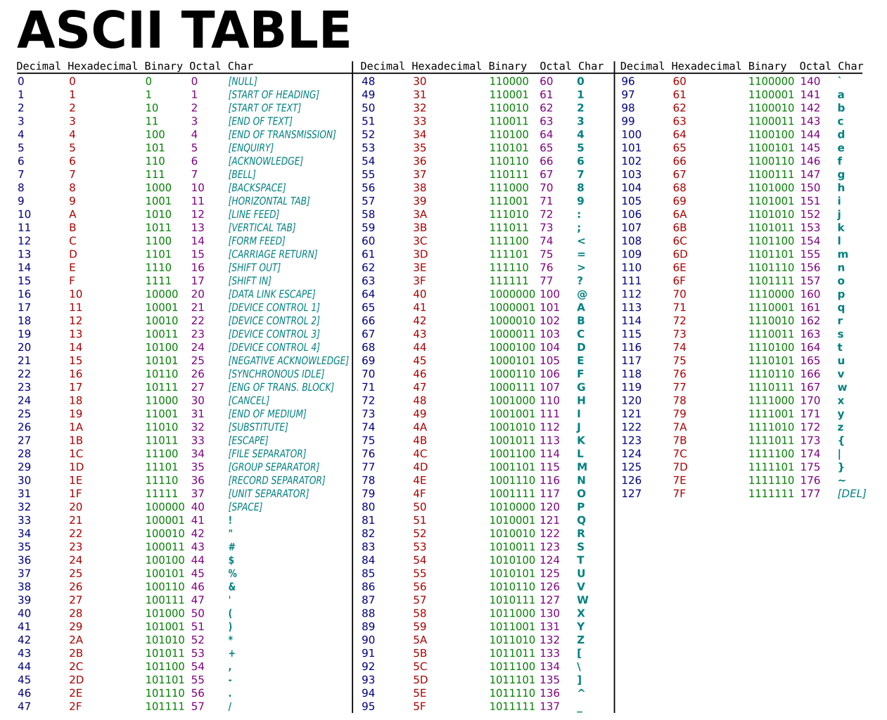
ASCII Table
https://commons.wikimedia.org/wiki/File:ASCII-Table.svg

Slide 14
Appendix C: C Programming
Functions

Slide 15
Functions
A function may take some inputs and may return at most one output
The type of the inputs is declared in the function declaration
Functions pass variables by value not reference
Curly braces {} enclose the body of the function, which may contain zero or more statements
The type of returned value is declared in the function declaration
The return statement indicates the value that the function should return to its caller
A function must be either declared BEFORE it is used or a function prototype declared BEFORE it is used

Slide 16
Function Example
// Return the sum of the three input variables
int sum3(int a, int b, int c) {
int result = a + b + c;
return result;
}

Slide 17
Function Prototypes
// sum3example.c
// David_Harris@hmc.edu 22 October 2019
////////////////////////////////
// Prototypes
////////////////////////////////
int sum3(int, int, int); // needed because sum3 is called before declared
////////////////////////////////
// main
////////////////////////////////
void main(void) {
int answer;
answer = sum3(6, 7, 8);
}
////////////////////////////////
// other functions
// prototype not needed if these were moved before main
////////////////////////////////
int sum3(int a, int b, int c) {
int result = a + b + c;
return result;
}

Slide 18
Prototypes are Sometimes Unavoidable
// Prototypes needed for f1 and/or f2 because they
// can’t both be declared before each other
int f1(int);
int f2(int);
int f1(int n) {
return f2(n-1) + 1;
}
int f2(int n) {
return f1(n-1)*2;
}
void main(void) {
int answer;
answer = f1(5);
}

Slide 19
Includes
The function prototypes for the standard libraries are included at the top of a file with the #include directive:
#include <stdio.h>
#include <math.h>
Your own function prototypes (or anything else you want to include) is done with quotes instead of brackets for relative or absolute path:
e.g., #include "other/myFuncs.h"

Slide 20
Appendix C: C Programming
Operators

Slide 21
Boolean (True/False) in C
A variable or expression is considered FALSE if its value is 0
A variable is considered TRUE if it has any other value
1, 42, and -1 are all TRUE for C
Logical operators assign FALSE as 0 and TRUE as 1

Slide 22
Operators and Precedence

Slide 23
Operators Continued

Slide 24
Operators Continued

Slide 25
Operators Continued

Slide 26
Examples
int a = 42;
int b = 0x15; // hexadecimal; = 21 in decimal
char c = 0b00001010; // binary; = 10 in decimal
char d = !c; // 0, because c was nonzero
char e = ~c; // 0b11110101 bitwise NOT
char f = e | c; // 0b11111111 bitwise OR
char g = c << 2; // 0b00101000 shift left by 2
int h = (a > b); // 1 because a is greater than b
int i = (a > b)&&(c != e); // 1 because both are TRUE
int j = (a > b) ? a : b; // 42 because a > b
int k = sizeof(a); // 4 on most computers
g &= c; // 0b00001000 bitwise AND

Slide 27
Appendix C: C Programming
Control Flow

Slide 28
Control Flow Statements
if
if (expression)
statement;
if/else
if (expression)
statement1;
else
statement2;
switch/case
switch (variable) { case (expression1): statement1; break;
case (expression2): statement2; break;
case (expression3): statement3; break;
default: statement4;
}
Don’t forget “break” or “default”

Slide 29
If example
if (n <= 1) return 1;

Slide 30
Compound Statements
When a statement has more than one line, enclose it in {}
if (answer == 42) {
ultimateQuestion = 1;
hitchhikersGuide = 1;
}

Slide 31
If/else example
if (n <= 1) return 1;
else return fact(n-1);

Slide 32
Switch/case example
switch (state) { case (0): if (ta) state = 0; else state = 1; break;
case (1): state = 2; break;
case (2): if (tb) state = 2; else state = 3; break;
case (3): state = 0; break;
default: state = 0;
}

Slide 33
Appendix C: C Programming
Loops

Slide 34
Loops
while
while (condition)
statement;
do/while
do {
statement;
} while (condition);
for
for (initialization; condition; loop operation)
statement;

Slide 35
While example
int fact(int n) {
int result = 1;
while (n > 1) {
result = result * n; // or write result *= n;
n = n – 1; // or write n--
}
return result;
}
// Alternative while loop is shorter but less clear
int fact(int n) {
int result = 1;
while (n > 1) result *= n--;
return result;
}

Slide 36
Do/while example
int fact(int n) {
int result = 1;
do {
result *= n;
} while (n-- > 1);
return result;
}
Do always executes the statement at least once.
Longer and not preferred for this example

Slide 37
For example
int fact(int n) {
int result = 1;
int i;
for (i=1; i <= n; i++)
result *= i;
return result;
}
First do initialization (i = 1)
Then check condition (i<=n)
If satisfied, do body (result *= i)
Then do loop operation (i++)
Then repeat from checking condition

Slide 38
Appendix C: C Programming
Arrays & Strings

Slide 39
Data Types: Arrays
Array contains multiple elements
float accel[3];
The elements are numbered from 0 to N−1, where N is the length of the array
Initialize your arrays.
An uninitialized array can contain anything
Arrays can be multidimensional
#define NUMSTUDENTS 120
#define NUMLABS 11
int grades[NUMSTUDENTS][NUMLABS];

Slide 40
Array Example
#include <math.h>
double mag(double v[3]) {
return sqrt(v[0]*v[0] + v[1]*v[1] + v[2]*v[2]);
}

Slide 41
Data Types: Strings
A string is an array of characters
Last entry is zero to indicate end (”NULL terminated”)
char name[20] = "BOB";
Stored as:
name[0] = 66; // ASCII value for B
name[1] = 79; // ASCII value for O
name[2] = 66; // ASCII value for B
name[3] = 0; // NULL termination
other entries are junk, ignored

Slide 42
Examples: String Handling
#define MAXLEN 80
int strlen(char str[]) {
int len=0;
while (str[len] && len < MAXLEN) len++;
return len;
}
void strcpy(char dest[], char src[]) {
int i = 0;
do {
dest[i] = src[i];
} while (src[i++] && i < MAXLEN);
}

Slide 43
Examples: Using Strings
#include <string.h>
#define MAXLEN 80
void main(void) {
char name[80];
int len;
char c;
strcpy(name, "BOB"); // copy BOB into name
len = strlen(name); // len = 3
c = name[1]; // c = 'O' (79)
}

Slide 44
Appendix C: C Programming
Structures

Slide 45
Structures
Store a collection of related information
General format:
struct name {
type1 element1;
type2 element2;
...
};

Slide 46
Structures
struct contact { char name[30]; int age; float height; // in meters
};
struct contact c1;
strcpy(c1.name, "Ben Bitdiddle”);
c1.age = 20;
c1.height = 1.82;

Slide 47
Typedef
If you’re using lots of the same structure, you can shorten your typing by using typedef.
typedef type name;
typedef struct contact {
char name[30];
int age;
float height; // in meters
} contact; // defines contact as shorthand for "struct contact”
contact c1; // now we can declare the variable as type contact

Slide 48
Structure Examples
typedef struct point {
int x;
int y;
} point;
point p1;
p1.x = 42; p1.y = 9;
typedef struct rect {
point ll;
point ur;
int color;
} rect;
rect r1;
r1.color = 1;
r1.ll = p1;
r1.ur.x = r1.ll.x + width;
r1.ur.y = r1.ll.y + height;

Slide 49
Appendix C: C Programming
Memory

Slide 50
Memory
Variables are stored in memory
Each primitive data type has a size
char 1 byte
short at least 2 bytes
long at least 4 bytes, 8 on some 64-bit computers
int at least 2 bytes, 4 on most 32 & 64-bit computers
float 4 bytes
double 8 bytes
Arrays & structs stored in multiple consecutive locations

Slide 51
Sizeof
Sizeof operator returns size of a datatype
char c;
double d;
point p;
rect r;
int s1 = sizeof c; // s1 = 1
int s2 = sizeof(d); // s2 = 8
int s3 = sizeof(p); // s3 = 4 + 4 = 8
int s4 = sizeof(r); // s4 = 8 + 8 + 4 = 20

Slide 52
Memory Example: Array

Slide 53
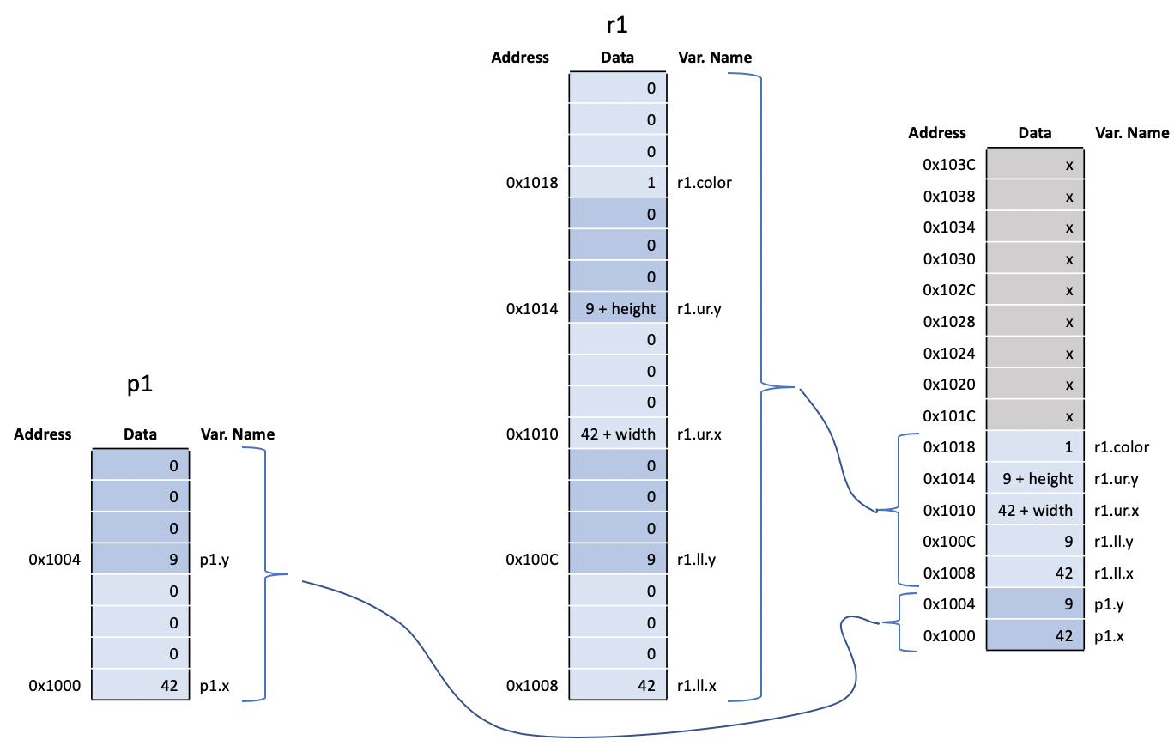
Memory Example: Structure

Slide 54
Appendix C: C Programming
Pointers

Slide 55
Pointers
A pointer is an address in memory
Pointer variables are declared with * and a data type to which the pointer points
int salary1, salary2;
int *ptr; // a pointer to an integer
& returns address of a variable
salary1 = 98500; // suppose this is at address 100 in memory
ptr = &salary1; // ptr contains 100 (the address of salary1)
* dereferences a pointer (finds value it points to)
salary2 = *ptr + 1000; // salary2 gets 99500

Slide 56
Arrays and Pointers
An array in C is viewed as the address of the zeroth element
Equivalent to a pointer to the beginning of the array

Slide 57
Pointer Example
Now add:
int ary[4]; // suppose at addresses 0x101C, 0x1020, 0x1024, 0x1028
int a = 37, b;
int *ptr;
int i;
Address | Data |  |  | Var. Name
0x103C | x
0x1038 | x
0x1034 | x
0x1030 | x
0x102C | x
0x1028 | x
0x1024 | x
0x1020 | x
0x101C | x
0x1018 | 1 |  |  | r1.color
0x1014 | 9 + height |  |  | r1.ur.y
0x1010 | 42 + width |  |  | r1.ur.x
0x100C | 9 |  |  | r1.ll.y
0x1008 | 42 |  |  | r1.ll.x
0x1004 | 9 |  |  | p1.y
0x1000 | 42 |  |  | p1.x

Slide 58
Pointer Example
Now add:
int ary[4]; // suppose at addresses 0x101C, 0x1020, 0x1024, 0x1028
int a = 37, b;
int *ptr;
int i;
Address | Data |  |  | Var. Name
0x103C | x
0x1038 | x
0x1034 | x
0x1030 | x
0x102C | x
0x1028 | x |  |  | ary[3]
0x1024 | x |  |  | ary[2]
0x1020 | x |  |  | ary[1]
0x101C | x |  |  | ary[0]
0x1018 | 1 |  |  | r1.color
0x1014 | 9 + height |  |  | r1.ur.y
0x1010 | 42 + width |  |  | r1.ur.x
0x100C | 9 |  |  | r1.ll.y
0x1008 | 42 |  |  | r1.ll.x
0x1004 | 9 |  |  | p1.y
0x1000 | 42 |  |  | p1.x

Slide 59
Pointer Example
Now add:
int ary[4]; // suppose at addresses 0x101C, 0x1020, 0x1024, 0x1028
int a = 37, b; // suppose at addresses 0x102C, 0x1030
int *ptr;
int i;
Address | Data |  |  | Var. Name
0x103C | x
0x1038 | x
0x1034 | x
0x1030 | x |  |  | b
0x102C | 37 |  |  | a
0x1028 | x |  |  | ary[3]
0x1024 | x |  |  | ary[2]
0x1020 | x |  |  | ary[1]
0x101C | x |  |  | ary[0]
0x1018 | 1 |  |  | r1.color
0x1014 | 9 + height |  |  | r1.ur.y
0x1010 | 42 + width |  |  | r1.ur.x
0x100C | 9 |  |  | r1.ll.y
0x1008 | 42 |  |  | r1.ll.x
0x1004 | 9 |  |  | p1.y
0x1000 | 42 |  |  | p1.x

Slide 60
Pointer Example
Now add:
int ary[4]; // suppose at addresses 0x101C, 0x1020, 0x1024, 0x1028
int a = 37, b; // suppose at addresses 0x102C, 0x1030
int *ptr; // suppose ptr is at address 0x1034, initially undefined
int i;
Address | Data |  |  | Var. Name
0x103C | x
0x1038 | x
0x1034 | x |  |  | ptr
0x1030 | x |  |  | b
0x102C | 37 |  |  | a
0x1028 | x |  |  | ary[3]
0x1024 | x |  |  | ary[2]
0x1020 | x |  |  | ary[1]
0x101C | x |  |  | ary[0]
0x1018 | 1 |  |  | r1.color
0x1014 | 9 + height |  |  | r1.ur.y
0x1010 | 42 + width |  |  | r1.ur.x
0x100C | 9 |  |  | r1.ll.y
0x1008 | 42 |  |  | r1.ll.x
0x1004 | 9 |  |  | p1.y
0x1000 | 42 |  |  | p1.x

Slide 61
Pointer Example
Now add:
int ary[4]; // suppose at addresses 0x101C, 0x1020, 0x1024, 0x1028
int a = 37, b; // suppose at addresses 0x102C, 0x1030
int *ptr; // suppose ptr is at address 0x1034, initially undefined
int i;
Address | Data |  |  | Var. Name
0x103C | x
0x1038 | x |  |  | i
0x1034 | x |  |  | ptr
0x1030 | x |  |  | b
0x102C | 37 |  |  | a
0x1028 | x |  |  | ary[3]
0x1024 | x |  |  | ary[2]
0x1020 | x |  |  | ary[1]
0x101C | x |  |  | ary[0]
0x1018 | 1 |  |  | r1.color
0x1014 | 9 + height |  |  | r1.ur.y
0x1010 | 42 + width |  |  | r1.ur.x
0x100C | 9 |  |  | r1.ll.y
0x1008 | 42 |  |  | r1.ll.x
0x1004 | 9 |  |  | p1.y
0x1000 | 42 |  |  | p1.x

Slide 62
Pointer Example
Now add:
int ary[4]; // suppose at addresses 0x101C, 0x1020, 0x1024, 0x1028
int a = 37, b; // suppose at addresses 0x102C, 0x1030
int *ptr; // suppose ptr is at address 0x1034, initially undefined
int i;
for (i=0; i<3; i++) ary[i] = i*i;
ptr = &a;
b = *ptr;
*ptr = 3;
ptr = ary;
ptr[1] = b;
*(ptr+2) = 7;
ary[4] = 1;
*(ptr+5) = 2;
Address | Data |  |  | Var. Name
0x103C | x
0x1038 | x |  |  | i
0x1034 | x |  |  | ptr
0x1030 | x |  |  | b
0x102C | 37 |  |  | a
0x1028 | x |  |  | ary[3]
0x1024 | x |  |  | ary[2]
0x1020 | x |  |  | ary[1]
0x101C | x |  |  | ary[0]
0x1018 | 1 |  |  | r1.color
0x1014 | 9 + height |  |  | r1.ur.y
0x1010 | 42 + width |  |  | r1.ur.x
0x100C | 9 |  |  | r1.ll.y
0x1008 | 42 |  |  | r1.ll.x
0x1004 | 9 |  |  | p1.y
0x1000 | 42 |  |  | p1.x

Slide 63
Pointer Example
Now add:
int ary[4]; // suppose at addresses 0x101C, 0x1020, 0x1024, 0x1028
int a = 37, b; // suppose at addresses 0x102C, 0x1030
int *ptr; // suppose ptr is at address 0x1034, initially undefined
int i;
for (i=0; i<3; i++) ary[i] = i*i; // Note: ary[3] not changed
ptr = &a;
b = *ptr;
*ptr = 3;
ptr = ary;
ptr[1] = b;
*(ptr+2) = 7;
ary[4] = 1;
*(ptr+5) = 2;
Address | Data |  |  | Var. Name
0x103C | x
0x1038 | 3 |  |  | i
0x1034 | x |  |  | ptr
0x1030 | x |  |  | b
0x102C | 37 |  |  | a
0x1028 | x |  |  | ary[3]
0x1024 | 4 |  |  | ary[2]
0x1020 | 1 |  |  | ary[1]
0x101C | 0 |  |  | ary[0]
0x1018 | 1 |  |  | r1.color
0x1014 | 9 + height |  |  | r1.ur.y
0x1010 | 42 + width |  |  | r1.ur.x
0x100C | 9 |  |  | r1.ll.y
0x1008 | 42 |  |  | r1.ll.x
0x1004 | 9 |  |  | p1.y
0x1000 | 42 |  |  | p1.x

Slide 64
Pointer Example
Now add:
int ary[4]; // suppose at addresses 0x101C, 0x1020, 0x1024, 0x1028
int a = 37, b; // suppose at addresses 0x102C, 0x1030
int *ptr; // suppose ptr is at address 0x1034, initially undefined
int i;
for (i=0; i<3; i++) ary[i] = i*i;
ptr = &a; // ptr = 0x102C
b = *ptr;
*ptr = 3;
ptr = ary;
ptr[1] = b;
*(ptr+2) = 7;
ary[4] = 1;
*(ptr+5) = 2;
Address | Data |  |  | Var. Name
0x103C | x
0x1038 | 3 |  |  | i
0x1034 | 0x102C |  |  | ptr
0x1030 | x |  |  | b
0x102C | 37 |  |  | a
0x1028 | x |  |  | ary[3]
0x1024 | 4 |  |  | ary[2]
0x1020 | 1 |  |  | ary[1]
0x101C | 0 |  |  | ary[0]
0x1018 | 1 |  |  | r1.color
0x1014 | 9 + height |  |  | r1.ur.y
0x1010 | 42 + width |  |  | r1.ur.x
0x100C | 9 |  |  | r1.ll.y
0x1008 | 42 |  |  | r1.ll.x
0x1004 | 9 |  |  | p1.y
0x1000 | 42 |  |  | p1.x

Slide 65
Pointer Example
Now add:
int ary[4]; // suppose at addresses 0x101C, 0x1020, 0x1024, 0x1028
int a = 37, b; // suppose at addresses 0x102C, 0x1030
int *ptr; // suppose ptr is at address 0x1034, initially undefined
int i;
for (i=0; i<3; i++) ary[i] = i*i;
ptr = &a; // ptr = 0x102C
b = *ptr; // dereference pointer, b = 37
*ptr = 3;
ptr = ary;
ptr[1] = b;
*(ptr+2) = 7;
ary[4] = 1;
*(ptr+5) = 2;
Address | Data |  |  | Var. Name
0x103C | x
0x1038 | 3 |  |  | i
0x1034 | 0x102C |  |  | ptr
0x1030 | 37 |  |  | b
0x102C | 37 |  |  | a
0x1028 | x |  |  | ary[3]
0x1024 | 4 |  |  | ary[2]
0x1020 | 1 |  |  | ary[1]
0x101C | 0 |  |  | ary[0]
0x1018 | 1 |  |  | r1.color
0x1014 | 9 + height |  |  | r1.ur.y
0x1010 | 42 + width |  |  | r1.ur.x
0x100C | 9 |  |  | r1.ll.y
0x1008 | 42 |  |  | r1.ll.x
0x1004 | 9 |  |  | p1.y
0x1000 | 42 |  |  | p1.x

Slide 66
Pointer Example
Now add:
int ary[4]; // suppose at addresses 0x101C, 0x1020, 0x1024, 0x1028
int a = 37, b; // suppose at addresses 0x102C, 0x1030
int *ptr; // suppose ptr is at address 0x1034, initially undefined
int i;
for (i=0; i<3; i++) ary[i] = i*i;
ptr = &a; // ptr = 0x102C
b = *ptr; // dereference pointer, b = 37
*ptr = 3; // a = 3
ptr = ary;
ptr[1] = b;
*(ptr+2) = 7;
ary[4] = 1;
*(ptr+5) = 2;
Address | Data |  |  | Var. Name
0x103C | x
0x1038 | 3 |  |  | i
0x1034 | 0x102C |  |  | ptr
0x1030 | 37 |  |  | b
0x102C | 3 |  |  | a
0x1028 | x |  |  | ary[3]
0x1024 | 4 |  |  | ary[2]
0x1020 | 1 |  |  | ary[1]
0x101C | 0 |  |  | ary[0]
0x1018 | 1 |  |  | r1.color
0x1014 | 9 + height |  |  | r1.ur.y
0x1010 | 42 + width |  |  | r1.ur.x
0x100C | 9 |  |  | r1.ll.y
0x1008 | 42 |  |  | r1.ll.x
0x1004 | 9 |  |  | p1.y
0x1000 | 42 |  |  | p1.x

Slide 67
Pointer Example
Now add:
int ary[4]; // suppose at addresses 0x101C, 0x1020, 0x1024, 0x1028
int a = 37, b; // suppose at addresses 0x102C, 0x1030
int *ptr; // suppose ptr is at address 0x1034, initially undefined
int i;
for (i=0; i<3; i++) ary[i] = i*i;
ptr = &a; // ptr = 0x102C
b = *ptr; // dereference pointer, b = 37
*ptr = 3; // a = 3
ptr = ary; // ptr = 0x101C
ptr[1] = b;
*(ptr+2) = 7;
ary[4] = 1;
*(ptr+5) = 2;
Address | Data |  |  | Var. Name
0x103C | x
0x1038 | 3 |  |  | i
0x1034 | 0x101C |  |  | ptr
0x1030 | 37 |  |  | b
0x102C | 3 |  |  | a
0x1028 | x |  |  | ary[3]
0x1024 | 4 |  |  | ary[2]
0x1020 | 1 |  |  | ary[1]
0x101C | 0 |  |  | ary[0]
0x1018 | 1 |  |  | r1.color
0x1014 | 9 + height |  |  | r1.ur.y
0x1010 | 42 + width |  |  | r1.ur.x
0x100C | 9 |  |  | r1.ll.y
0x1008 | 42 |  |  | r1.ll.x
0x1004 | 9 |  |  | p1.y
0x1000 | 42 |  |  | p1.x

Slide 68
Pointer Example
Now add:
int ary[4]; // suppose at addresses 0x101C, 0x1020, 0x1024, 0x1028
int a = 37, b; // suppose at addresses 0x102C, 0x1030
int *ptr; // suppose ptr is at address 0x1034, initially undefined
int i;
for (i=0; i<3; i++) ary[i] = i*i;
ptr = &a; // ptr = 0x102C
b = *ptr; // dereference pointer, b = 37
*ptr = 3; // a = 3
ptr = ary; // ptr = 0x101C
ptr[1] = b; // ary[1] = 37
*(ptr+2) = 7;
ary[4] = 1;
*(ptr+5) = 2;
Address | Data |  |  | Var. Name
0x103C | x
0x1038 | 3 |  |  | i
0x1034 | 0x101C |  |  | ptr
0x1030 | 37 |  |  | b
0x102C | 3 |  |  | a
0x1028 | x |  |  | ary[3]
0x1024 | 4 |  |  | ary[2]
0x1020 | 37 |  |  | ary[1]
0x101C | 0 |  |  | ary[0]
0x1018 | 1 |  |  | r1.color
0x1014 | 9 + height |  |  | r1.ur.y
0x1010 | 42 + width |  |  | r1.ur.x
0x100C | 9 |  |  | r1.ll.y
0x1008 | 42 |  |  | r1.ll.x
0x1004 | 9 |  |  | p1.y
0x1000 | 42 |  |  | p1.x

Slide 69
Pointer Example
Now add:
int ary[4]; // suppose at addresses 0x101C, 0x1020, 0x1024, 0x1028
int a = 37, b; // suppose at addresses 0x102C, 0x1030
int *ptr; // suppose ptr is at address 0x1034, initially undefined
int i;
for (i=0; i<3; i++) ary[i] = i*i;
ptr = &a; // ptr = 0x102C
b = *ptr; // dereference pointer, b = 37
*ptr = 3; // a = 3
ptr = ary; // ptr = 0x101C
ptr[1] = b; // ary[1] = 37
*(ptr+2) = 7; // ary[2] = 7, note offset is in int sizes, not bytes
ary[4] = 1;
*(ptr+5) = 2;
Address | Data |  |  | Var. Name
0x103C | x
0x1038 | 3 |  |  | i
0x1034 | 0x101C |  |  | ptr
0x1030 | 37 |  |  | b
0x102C | 3 |  |  | a
0x1028 | x |  |  | ary[3]
0x1024 | 7 |  |  | ary[2]
0x1020 | 37 |  |  | ary[1]
0x101C | 0 |  |  | ary[0]
0x1018 | 1 |  |  | r1.color
0x1014 | 9 + height |  |  | r1.ur.y
0x1010 | 42 + width |  |  | r1.ur.x
0x100C | 9 |  |  | r1.ll.y
0x1008 | 42 |  |  | r1.ll.x
0x1004 | 9 |  |  | p1.y
0x1000 | 42 |  |  | p1.x

Slide 70
Pointer Example
Now add:
int ary[4]; // suppose at addresses 0x101C, 0x1020, 0x1024, 0x1028
int a = 37, b; // suppose at addresses 0x102C, 0x1030
int *ptr; // suppose ptr is at address 0x1034, initially undefined
int i;
for (i=0; i<3; i++) ary[i] = i*i;
ptr = &a; // ptr = 0x102C
b = *ptr; // dereference pointer, b = 37
*ptr = 3; // a = 3
ptr = ary; // ptr = 0x101C
ptr[1] = b; // ary[1] = 37
*(ptr+2) = 7; // ary[2] = 7, note offset is in int sizes, not bytes
ary[4] = 1; // a = 1, BAD: trash variable past end of array
*(ptr+5) = 2;
Address | Data |  |  | Var. Name
0x103C | x
0x1038 | 3 |  |  | i
0x1034 | 0x101C |  |  | ptr
0x1030 | 37 |  |  | b
0x102C | 1 |  |  | a
0x1028 | x |  |  | ary[3]
0x1024 | 7 |  |  | ary[2]
0x1020 | 37 |  |  | ary[1]
0x101C | 0 |  |  | ary[0]
0x1018 | 1 |  |  | r1.color
0x1014 | 9 + height |  |  | r1.ur.y
0x1010 | 42 + width |  |  | r1.ur.x
0x100C | 9 |  |  | r1.ll.y
0x1008 | 42 |  |  | r1.ll.x
0x1004 | 9 |  |  | p1.y
0x1000 | 42 |  |  | p1.x

Slide 71
Pointer Example
Now add:
int ary[4]; // suppose at addresses 0x101C, 0x1020, 0x1024, 0x1028
int a = 37, b; // suppose at addresses 0x102C, 0x1030
int *ptr; // suppose ptr is at address 0x1034, initially undefined
int i;
for (i=0; i<3; i++) ary[i] = i*i;
ptr = &a; // ptr = 0x102C
b = *ptr; // dereference pointer, b = 37
*ptr = 3; // a = 3
ptr = ary; // ptr = 0x101C
ptr[1] = b; // ary[1] = 37
*(ptr+2) = 7; // ary[2] = 7, note offset is in int sizes, not bytes
ary[4] = 1; // a = 1, BAD: trash variable past end of array
*(ptr+5) = 2; // b = 2, BAD: trash variable past end of array
Address | Data |  |  | Var. Name
0x103C | x
0x1038 | 3 |  |  | i
0x1034 | 0x101C |  |  | ptr
0x1030 | 2 |  |  | b
0x102C | 1 |  |  | a
0x1028 | x |  |  | ary[3]
0x1024 | 7 |  |  | ary[2]
0x1020 | 37 |  |  | ary[1]
0x101C | 0 |  |  | ary[0]
0x1018 | 1 |  |  | r1.color
0x1014 | 9 + height |  |  | r1.ur.y
0x1010 | 42 + width |  |  | r1.ur.x
0x100C | 9 |  |  | r1.ll.y
0x1008 | 42 |  |  | r1.ll.x
0x1004 | 9 |  |  | p1.y
0x1000 | 42 |  |  | p1.x

Slide 72
Another Example
C Code
Program Output
#include <stdio.h>
int main (void)
{
char age = 30;
char *p;
p = &age;
printf("age = %d\n", age);
printf("p = %p\n", p);
printf("*p = %d\n", *p);
printf("sizeof(age) = %ld\n", sizeof(age));
printf("sizeof(p) = %ld\n", sizeof(p));
*p = 40;
printf("*p = %d\n", *p);
printf("age = %d\n", age);
return 0;
}
age = 30
p = 0x7ffee311e82b
*p = 30
sizeof(age) = 1
sizeof(p) = 8
*p = 40
age = 40

Slide 73
Another Example
C Code
Program Output
#include <stdio.h>
int main (void)
{
char age = 30;
char *p;
p = &age;
printf("age = %d\n", age);
printf("p = %p\n", p);
printf("*p = %d\n", *p);
printf("sizeof(age) = %ld\n", sizeof(age));
printf("sizeof(p) = %ld\n", sizeof(p));
*p = 40;
printf("*p = %d\n", *p);
printf("age = %d\n", age);
return 0;
}
age = 30
p = 0x7ffee311e82b
*p = 30
sizeof(age) = 1
sizeof(p) = 8
*p = 40
age = 40

Slide 74
Pointers and Structures
Address | Data |  |  | Var. Name
0x103C | x
0x1038 | 3 |  |  | i
0x1034 | 0x101C |  |  | ptr
0x1030 | 2 |  |  | b
0x102C | 1 |  |  | a
0x1028 | x |  |  | ary[3]
0x1024 | 7 |  |  | ary[2]
0x1020 | 37 |  |  | ary[1]
0x101C | 0 |  |  | ary[0]
0x1018 | 1 |  |  | r1.color
0x1014 | 9 + height |  |  | r1.ur.y
0x1010 | 42 + width |  |  | r1.ur.x
0x100C | 9 |  |  | r1.ll.y
0x1008 | 42 |  |  | r1.ll.x
0x1004 | 9 |  |  | p1.y
0x1000 | 42 |  |  | p1.x
rect *rptr; // Let rptr know it’s pointing to a rect
rptr = &r1; // Have rptr point at r1
(*rptr).color = 3; // Change r1.color to 3
rptr->color = 4; // Change r1.color to 4
// Use dot “.” when you are using the structure name.
// Arrow “->” (member access operator) is preferred when you are using the pointer.

Slide 75
Appendix C: C Programming
Memory
Odds & Ends

Slide 76
Passing Structures to Functions
Complex data structures and arrays are normally passed to C programs by address rather than copied; it’s more efficient.
void createRect(int xl, int yl, int width, int height, int color, rect *r) {
r->ll.x = x1; r->ll.y = yl;
r->ur.x = xl + width; r->ur.y = yl + height;
r->color = color;
}
int main(void) {
rect r1;
createRect(3, 5, 10, 20, 1, &r1);
}

Slide 77
Multidimensional Arrays
Address0 | Entry
0x1068 | field[1][2][2]
0x1060 | field[1][2][1]
0x1068 | field[1][2][0]
0x1060 | field[1][1][2]
0x1068 | field[1][1][1]
0x1060 | field[1][1][0]
0x1068 | field[1][0][2]
0x1060 | field[1][0][1]
0x1068 | field[1][0][0]
0x1060 | field[0][2][2]
0x1068 | field[0][2][1]
0x1060 | field[0][2][0]
0x1068 | field[0][1][2]
0x1060 | field[0][1][1]
0x1058 | field[0][1][0]
0x1050 | field[0][0][2]
0x1048 | field[0][0][1]
0x1040 | field[0][0][0]
Stored in consecutive addresses
last dimension first
double field[2][3][3];

Slide 78
Complex Structures in Memory
Address | Entry
0x277E | z[9].s[15]
.. | …
0x217E | z[1][s[15]
.. | …
0x20C0 | z[1].d[0][0]
0x20BE | z[0].s[15]
… | …
0x20A2 | z[0].s[1]
0x20A0 | z[0].s[0]
0x2098 | z[0].d[3][4]
… | …
0x2008 | z[0].d[0][1]
0x2000 | z[0].d[0][0]
typedef struct foo {
double d[4][5];
unsigned short s[16];
} foo;
foo z[10];
int s5 = sizeof(z[0]);
// 8*4*5 + 2*16 = 192 = 0xC0
int s5 = sizeof(z);
// 10*192 = 1920 = 0x780

Slide 79
Appendix C: C Programming
Dynamic
Memory
Allocation

Slide 80
Memory Allocation
malloc returns a pointer to allocated memory of a certain number of bytes.
free frees this memory.
These functions are declared in stdlib
int *ary = (int*)malloc(10*sizeof(int));

Slide 81
Example: Variable Sized Arrays
In standard C, multidimensional array sizes must be declared at compile time.
Treat variable-sized M row x N column array as 1-dimensional array of M x N entries

Slide 82
Variable Dimension Matrix Example
#include <stdlib.h> // for malloc
double* newMatrix(int m, int n) {
double *mat;
mat = (double*)malloc(m*n*sizeof(double));
return mat;
}
double* newIdentityMatrix(int n) {
double *mat = newMatrix(n, n);
int i, j;
for (i=0; i<n; i++)
for (j=0; j<n; j++)
mat[j+i*n] = (i==j);
return mat;
}

Slide 83
Variable Dimension Matrix Example
void scaleMatrix(double *mat, double *scaled, int m, int n, double c) {
int i, j;
for (i=0; i<m; i++)
for (j=0; j<n; j++)
scaled[j+i*n] = mat[j+i*n]*c;
}
int main(void) {
double *m1, *m2;
m1 = newIdentityMatrix(3);
m2 = newMatrix(3, 3);
scaleMatrix(m1, m2, 3, 3, 10);
free(m1);
}

Slide 84
About these Notes
Digital Design and Computer Architecture Lecture Notes
© 2021 Sarah Harris and David Harris
These notes may be used and modified for educational and/or non-commercial purposes so long as the source is attributed.

